Slide 1


Daria Solodey
Methodist, course creator

Slide 3

Lesson Plan:
Talk about stress at work
Practice answering the question:
“Tell me about a difficult/stressful situation at your work”
Notes:
Развернутый комментарий.

Slide 4

Have you ever felt the same? What causes stress in the workplace? Are you often stressed at work?

Slide 5

What's Dwight’s main goal here? How are people’s reactions?
Have you ever had a stressful situation at work? How do you behave in stressful situations? What is right to do in this case?

Slide 6
Tell me about a difficult/stressful situation at your work
Why do employers ask this question?

Slide 7
Tell me about a difficult/stressful situation at your work
Why do employers ask this question?
Asking this question gives an interviewer insight on many key traits including:
How well you listen
How you prioritize
Your communication skills
The ways you deal with conflict, deadlines, and other work pressures
The strength of your leadership skills
Your instincts to ask for help when needed

Slide 8
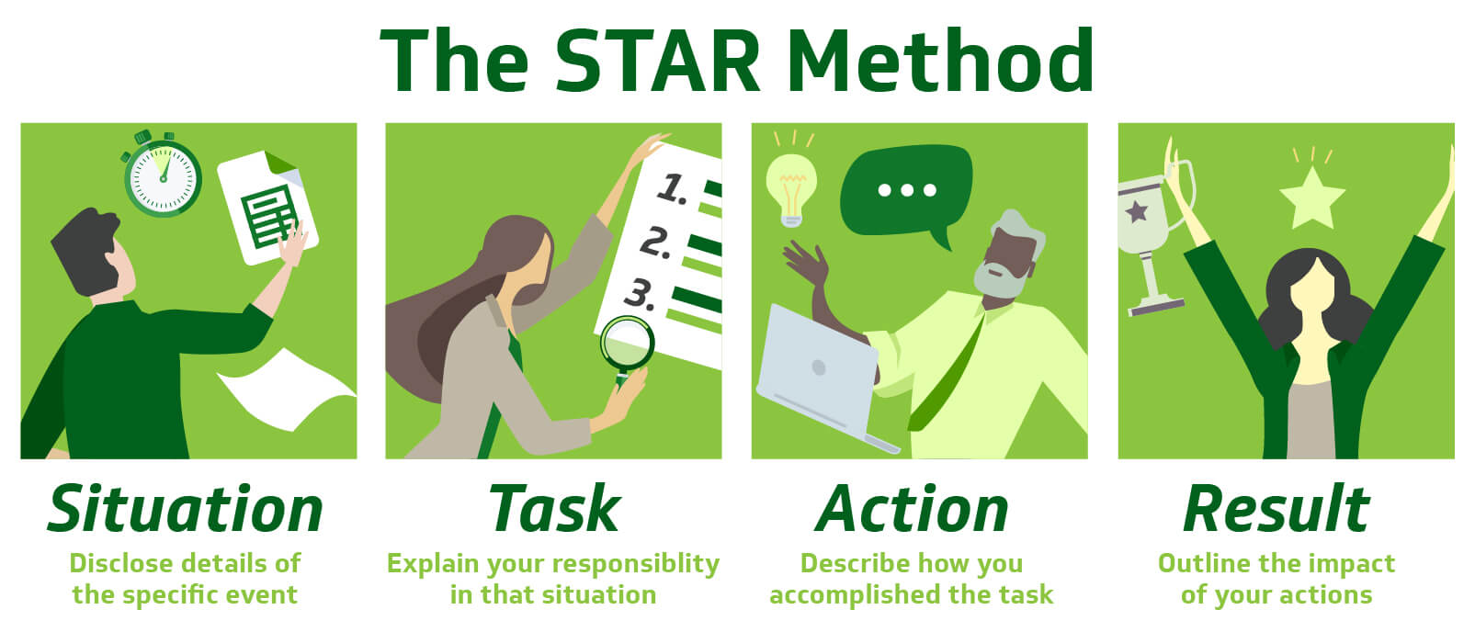
How to answer the question:
Tell me about a difficult/stressful situation
at your work
In 2021 I got
a challenging task from my boss.
For the last two quarters, I had to produce 8 new website pages.
I divided the goal into smaller targets which made it easier for me to create the layout, content and guide the developers to create the pages before the end of December 2021.
I completed the task successfully and got a promotion.

Slide 9
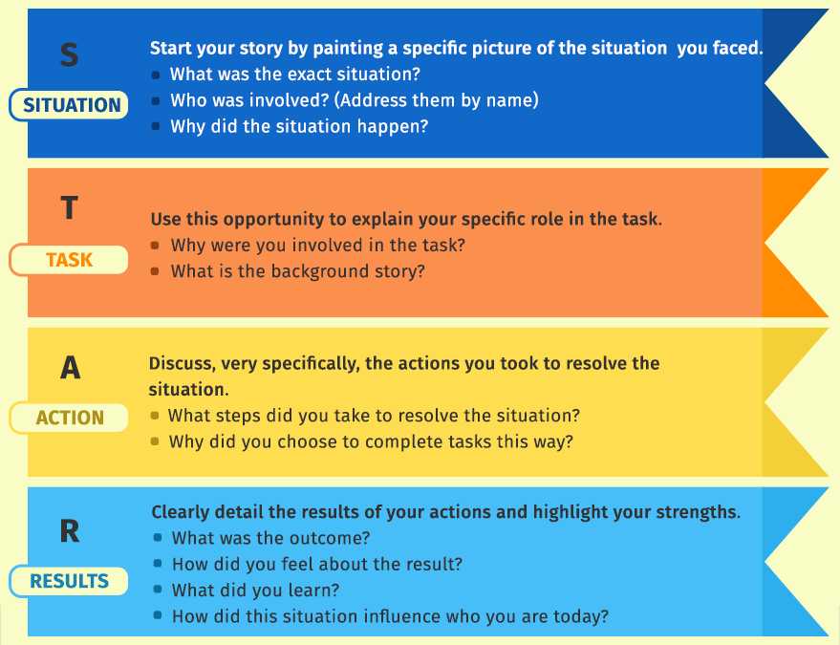
Tell me about a difficult/stressful situation
at your work
Use the STAR method and answer the interview question:

Slide 10

What may cause stress at work?

Slide 11
What may cause stress at work?
workload (overload and underload)
lack of time to complete a task
skills / abilities do not match job demands
lack of training and/or preparation (technical and social)
isolation at the workplace (emotional or working alone)
level of responsibility
job security/insecurity
lack of support (such as family-friendly policies, employee assistance programs, etc.)

Slide 12
1) Poll
study in which people are asked for their opinions
a way of discovering what someone knows
2) Pile up
to increase in amount
unable to change or get away from a situation
3) Maintain
to give someone something that they need
to continue to have
4) Circumstance
a condition or fact that affects a situation
the action of keeping away from something
5) Output
something obtained by calculation or investigation
the amount produced by a person in a given time
6) Accomplishment
the successful achievement of a task
the expression of approval for someone
7) Recap
sum up
keep it short
8) Excess
be better than; surpass
an amount of something that is more than necessary

Slide 13
1) Poll
study in which people are asked for their opinions
a way of discovering what someone knows
2) Pile up
to increase in amount
unable to change or get away from a situation
3) Maintain
to give someone something that they need
to continue to have
4) Circumstance
a condition or fact that affects a situation
the action of keeping away from something
5) Output
something obtained by calculation or investigation
the amount produced by a person in a given time
6) Accomplishment
the successful achievement of a task
the expression of approval for someone
7) Recap
sum up
keep it short
8) Excess
be better than; surpass
an amount of something that is more than necessary

Slide 14
Have you ever taken part in a poll? What was that about?
Is there any excess in your life? What is it?
Do you maintain contact with all your relatives?
Recap briefly your biggest accomplishments in 2021
What circumstances make you study IT to obtain a new profession?
Are you prone to put off your work until it piles up significantly?

Slide 15
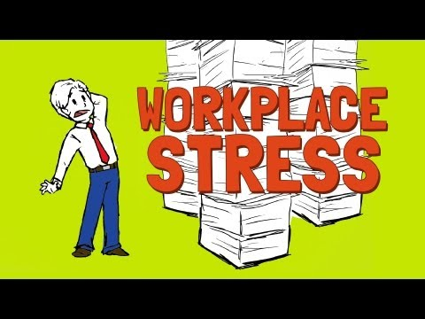
Watch the video and answer the questions
What’s the video about?
How many workers are stressed according to the research?
What causes workplace stress?
Does stress influence your health?
What problems may it cause?
How can you reduce stress?

Slide 16
What are three possible reactions to stressful situations?
What advice is given in the video on how to reduce stress?
Would you try such a way when you’re stressed?
What do you usually do to distress?

Slide 17

What can you do after this lesson?
I learned:
What stress is and how to cope with it
How to answer the question: “Tell me about a difficult/stressful situation at your work”
Notes:
Развернутый комментарий

Slide 18
Useful links:
Videos:
Dwight's Fire Drill - The Office
The Workplace Stress Solution
Words from this lesson:
Glossary 5

Slide 19
Thank you!

